Slide 1
Annihilating Workloads with Azure Functions
Kevin Griffin – Orlando Code Camp

Slide 2
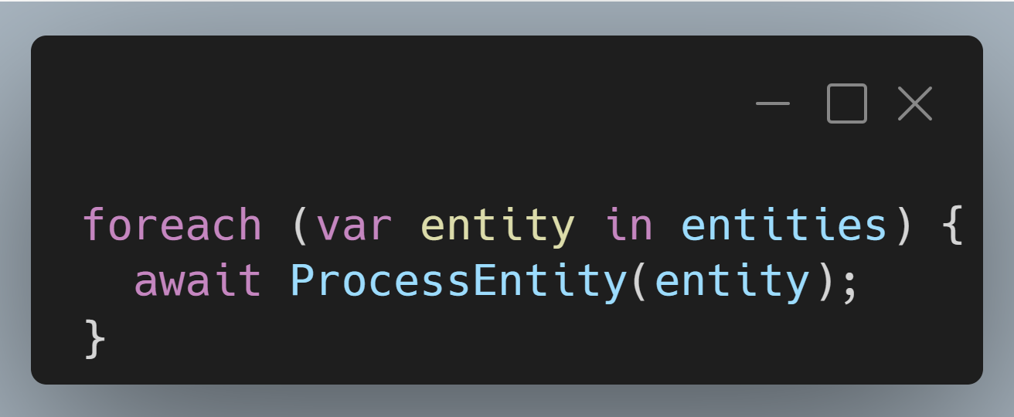
Entity 0 000 000
Entity 0 000 001
Entity 0 000 001
Entity 2 000 000

Slide 3
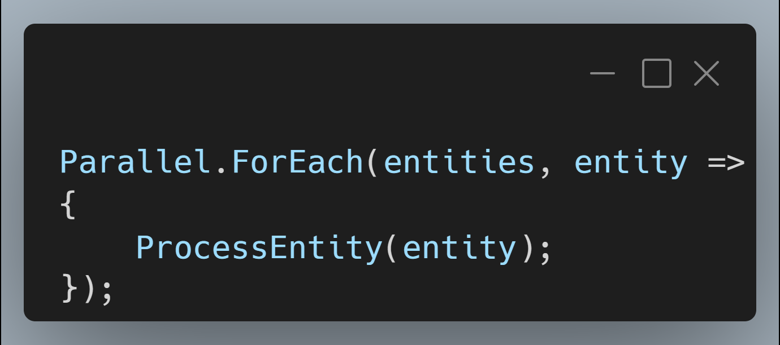
Entity 0 000 000
Entity 0 000 001
Entity 0 000 001
Entity 2 000 000

Slide 4
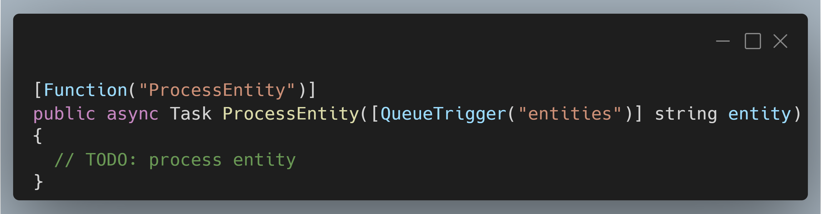
Entity 0 000 000
Entity 0 000 001
Entity 0 000 001
Entity 2 000 000

Slide 5
Entity 0 000 000
Entity 0 000 001
Entity 0 000 001
Entity 2 000 000

Slide 6

Hi, I’m Kevin

Slide 7
Kevin Griffin 13-time Microsoft MVP ASP.NET Core, Azure, and Web consultwithgriff.com twitter.com/@1kevgriff bbiz.io/@1kevgriff

Slide 8
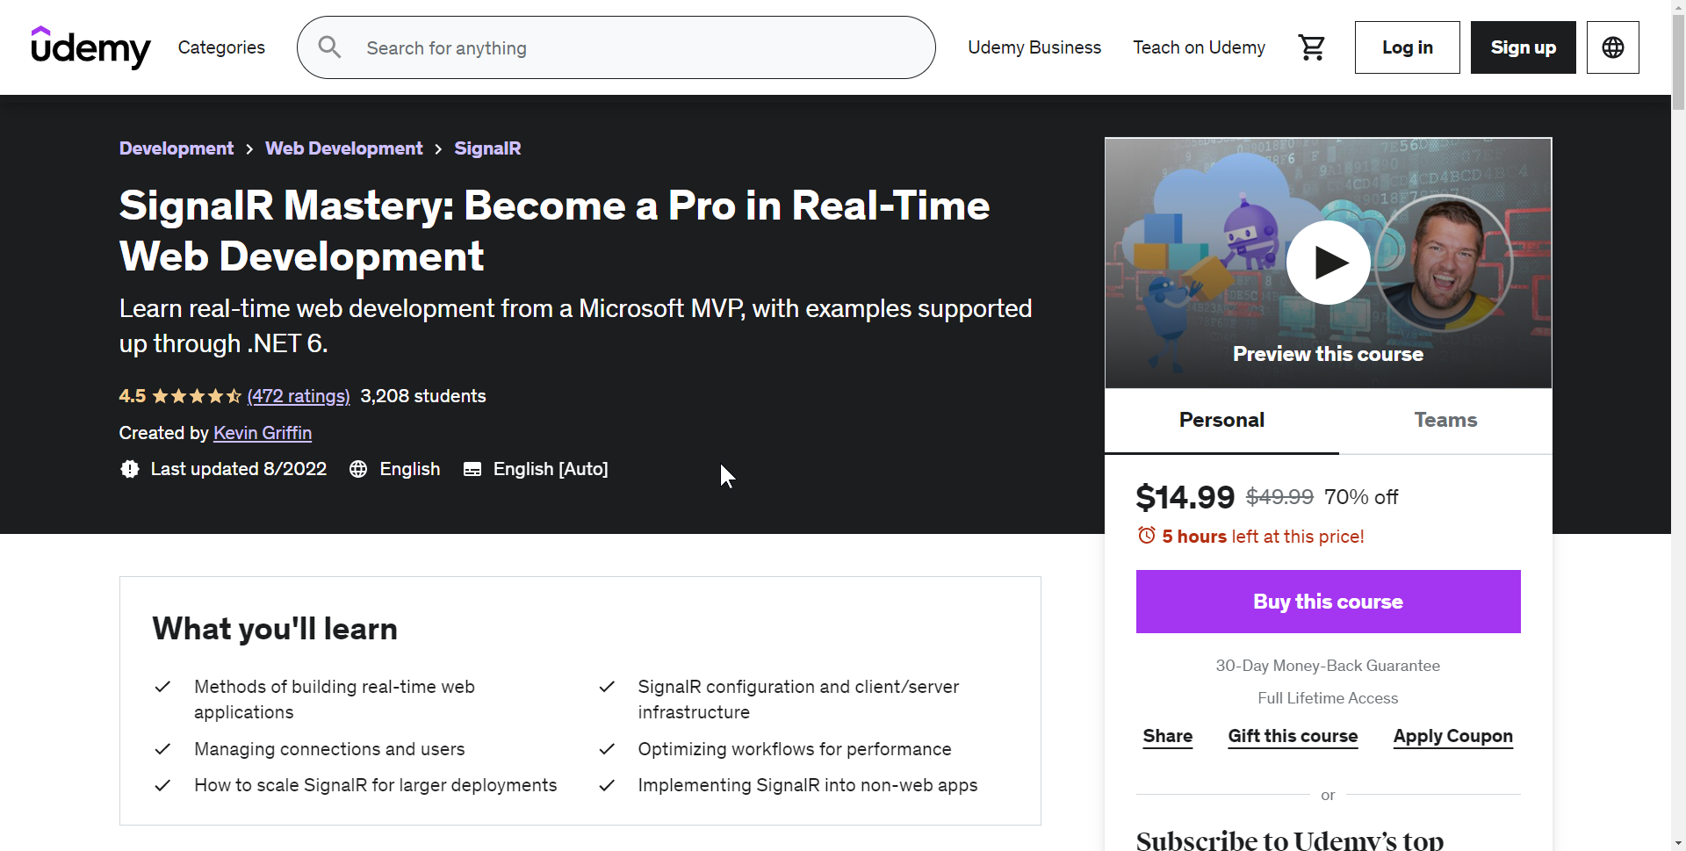
Courses
https://SignalRMastery.com – USE CODE OCC2023 FOR 100% OFF

Slide 9

Agenda
The “Promise of Serverless”
100-level Intro of Azure Functions
Designing Workflows for Azure Functions
Durability
Notes:
Adding tools to your tool box

Slide 10
The “Promise of Serverless”
Notes:
Important to abstract out background tasks from your UI or front facing work

Slide 11

“It’s just someone else's servers”

Slide 12
Application Host
Function
Function
Function
Function
Function
Function
Function
Function

Slide 13


Application Host
Function
Function
Function
Function
Function
Function
Function
Function

Slide 14

Application Host
Function
Function
Function
Function
Function
Function
Function
Function

Slide 15
Application Host
Function
Function
Function
Application Host
Function
Function
Function
Function
Function
Function
Function
Application Host
Function
Function
Function
Function
Function
Function
Function
Function
Function
Function
Function
Function
Function
Function

Slide 16
Application Host
Function
Function
Function
Application Host
Function
Function
Function
Function
Function
Function
Function
Application Host
Function
Function
Function
Function
Function
Function
Function
Function
Function
Function
Function
Function
Function
Function

Slide 17
Functions Host
Function
Function
Function
Function
Function
Function
Function
Function

Slide 18

Functions Host
Function
Function
Function
Function
Function
Function
Function
Function

Slide 19
Functions Host
Function
Function
Function
Function
Function
Functions Host
Function
Function
Function
Function
Function
Function
Function
Function
Functions Host
Function
Function
Function
Function
Function
Function
Function
Function
Function
Function
Function

Slide 20
Functions Host
Function
Function
Function
Function
Function
Functions Host
Function
Function
Function
Function
Function
Function
Function
Function
Functions Host
Function
Function
Function
Function
Function
Function
Function
Function
Function
Function
Function

Slide 21
100-level Azure Functions

Slide 22
Trigger => Action

Slide 23
BlobTrigger
Function
QueueTrigger
Function
HttpTrigger
Function

Slide 24
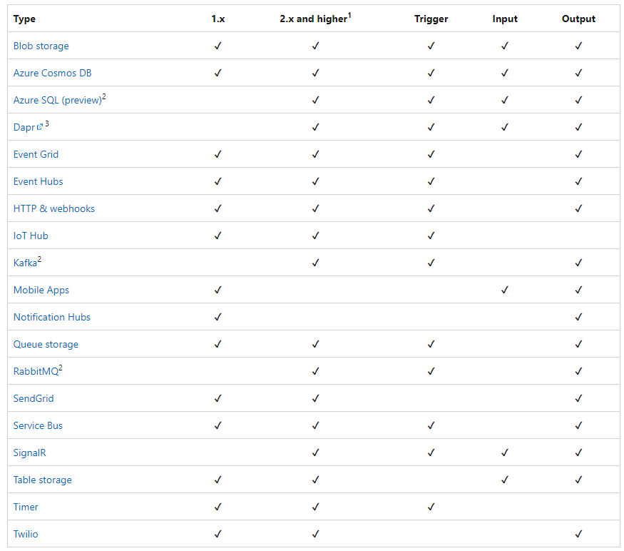

Slide 25
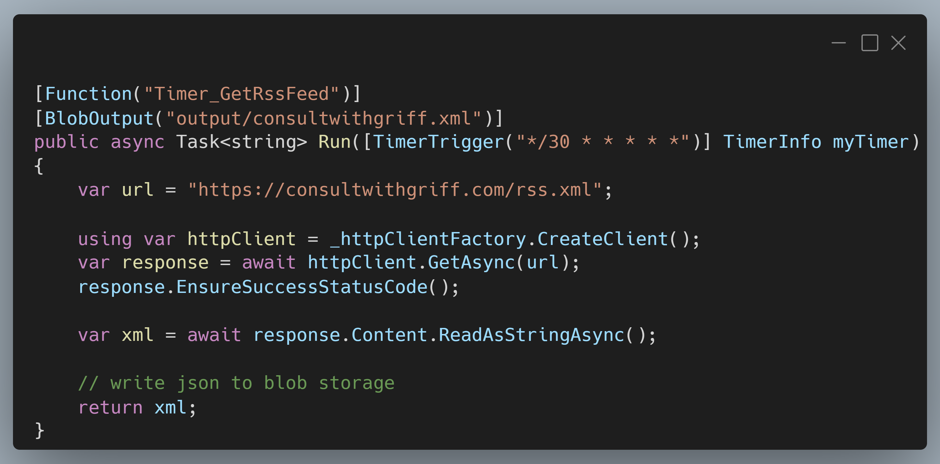

Slide 26
Azure Functions
Write in the language of your choice
C# / F#
JavaScript / TypeScript
Python
Powershell
Java

Slide 27
Azure Functions
Consumption-based pricing*
Scales automatically based off your rules or your workload

Slide 28
Designing Workflows

Slide 29
HttpTrigger
Function
Function
Function
Queue
Function
Producer / Consumer
Pattern
Function

Slide 30
Benefits to this approach

Slide 31
First: Extreme speed…

Slide 32
Second: Automatic retries and poison queues

Slide 33
Let’s do a demo!

Slide 34
There are drawbacks to this approach though…

Slide 35
First: how do you do workflows?

Slide 36
Function
Function
HttpTrigger
Function
Function
Function
Function
Function
Queue
Function
Queue
Function

Slide 37
That’s not the best…

Slide 38
Durable Functions

Slide 39
Durable Functions
Allows for “stateful” functions
Orchestrators managing state – allowing for checkpoints and restarts if necessary!

Slide 40
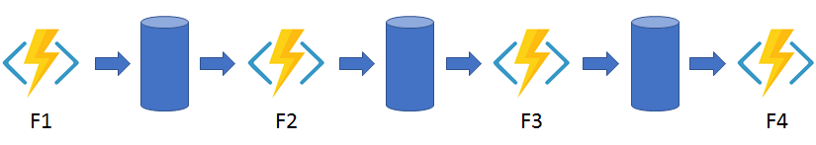
Durable Functions: Chaining

Slide 41
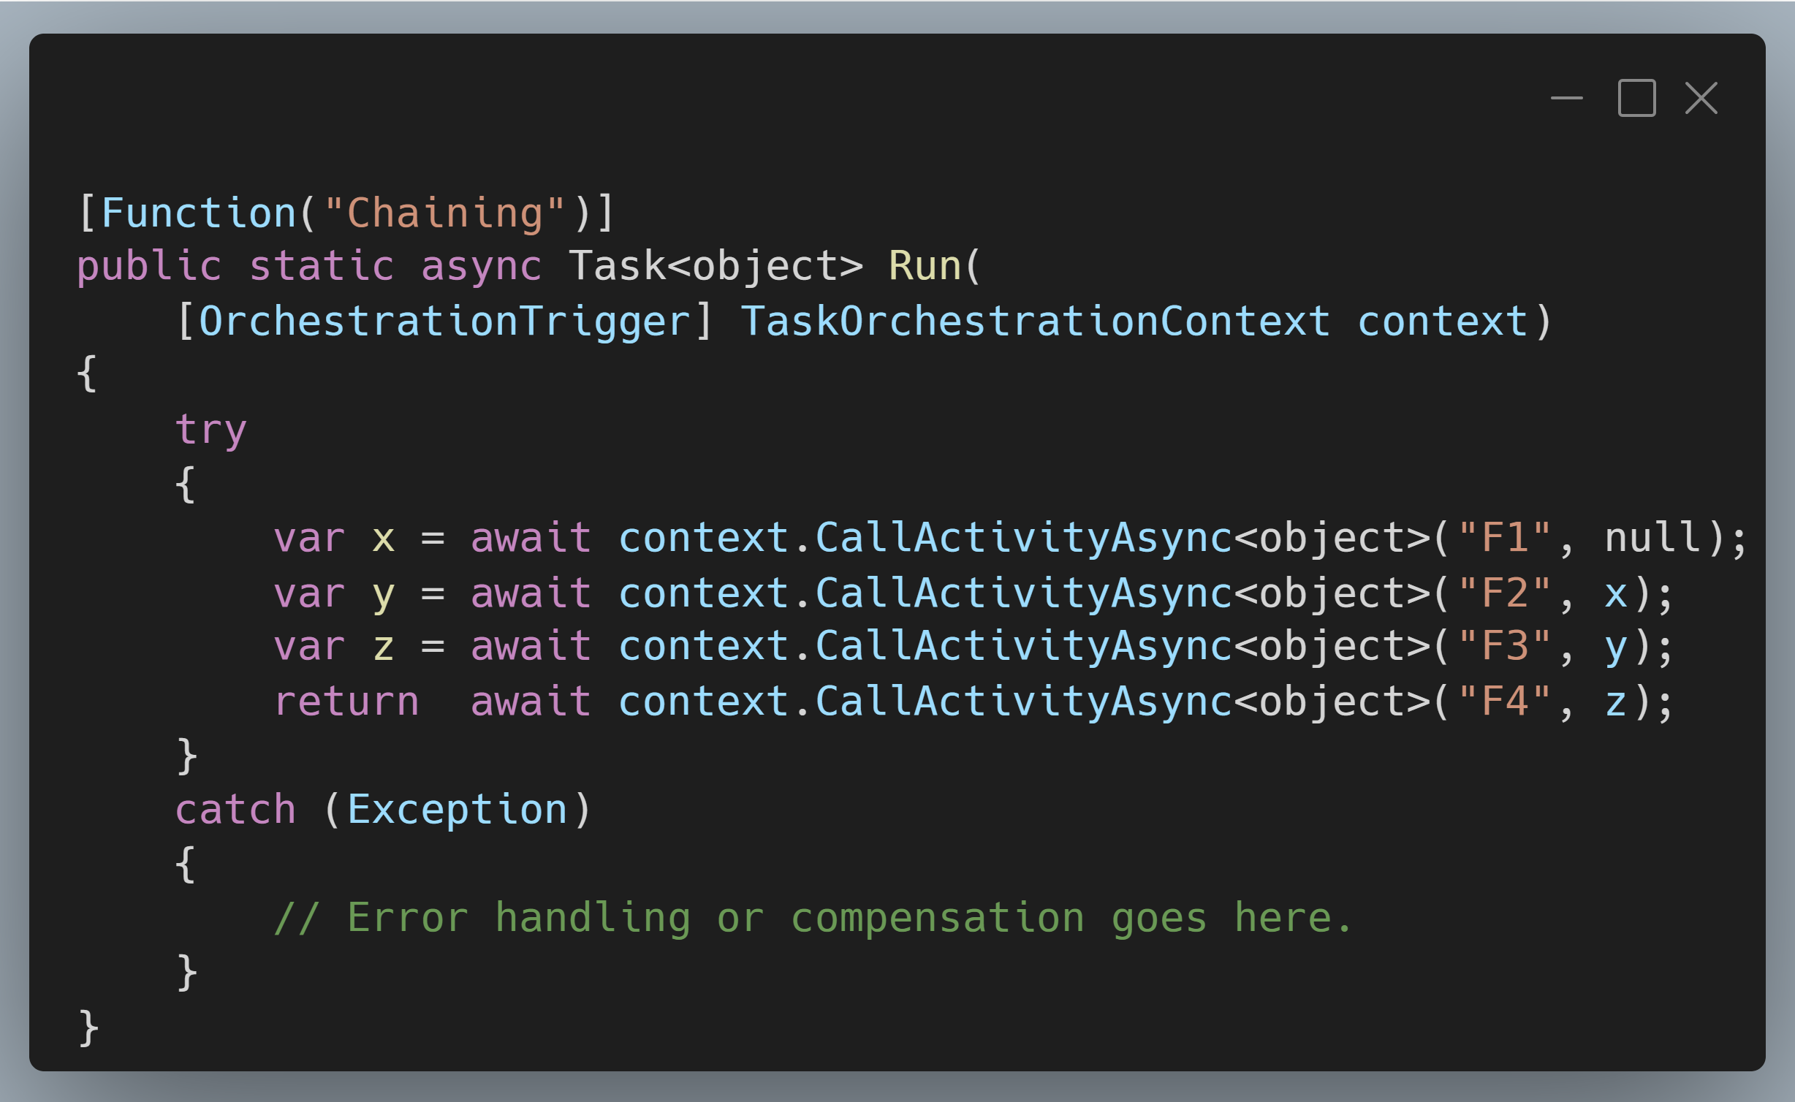
Durable Functions: Chaining

Slide 42
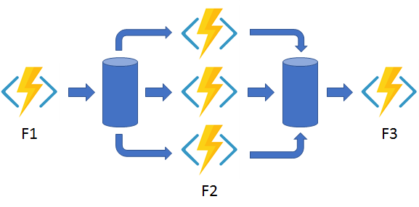
Durable Functions: Fan In/Out

Slide 43
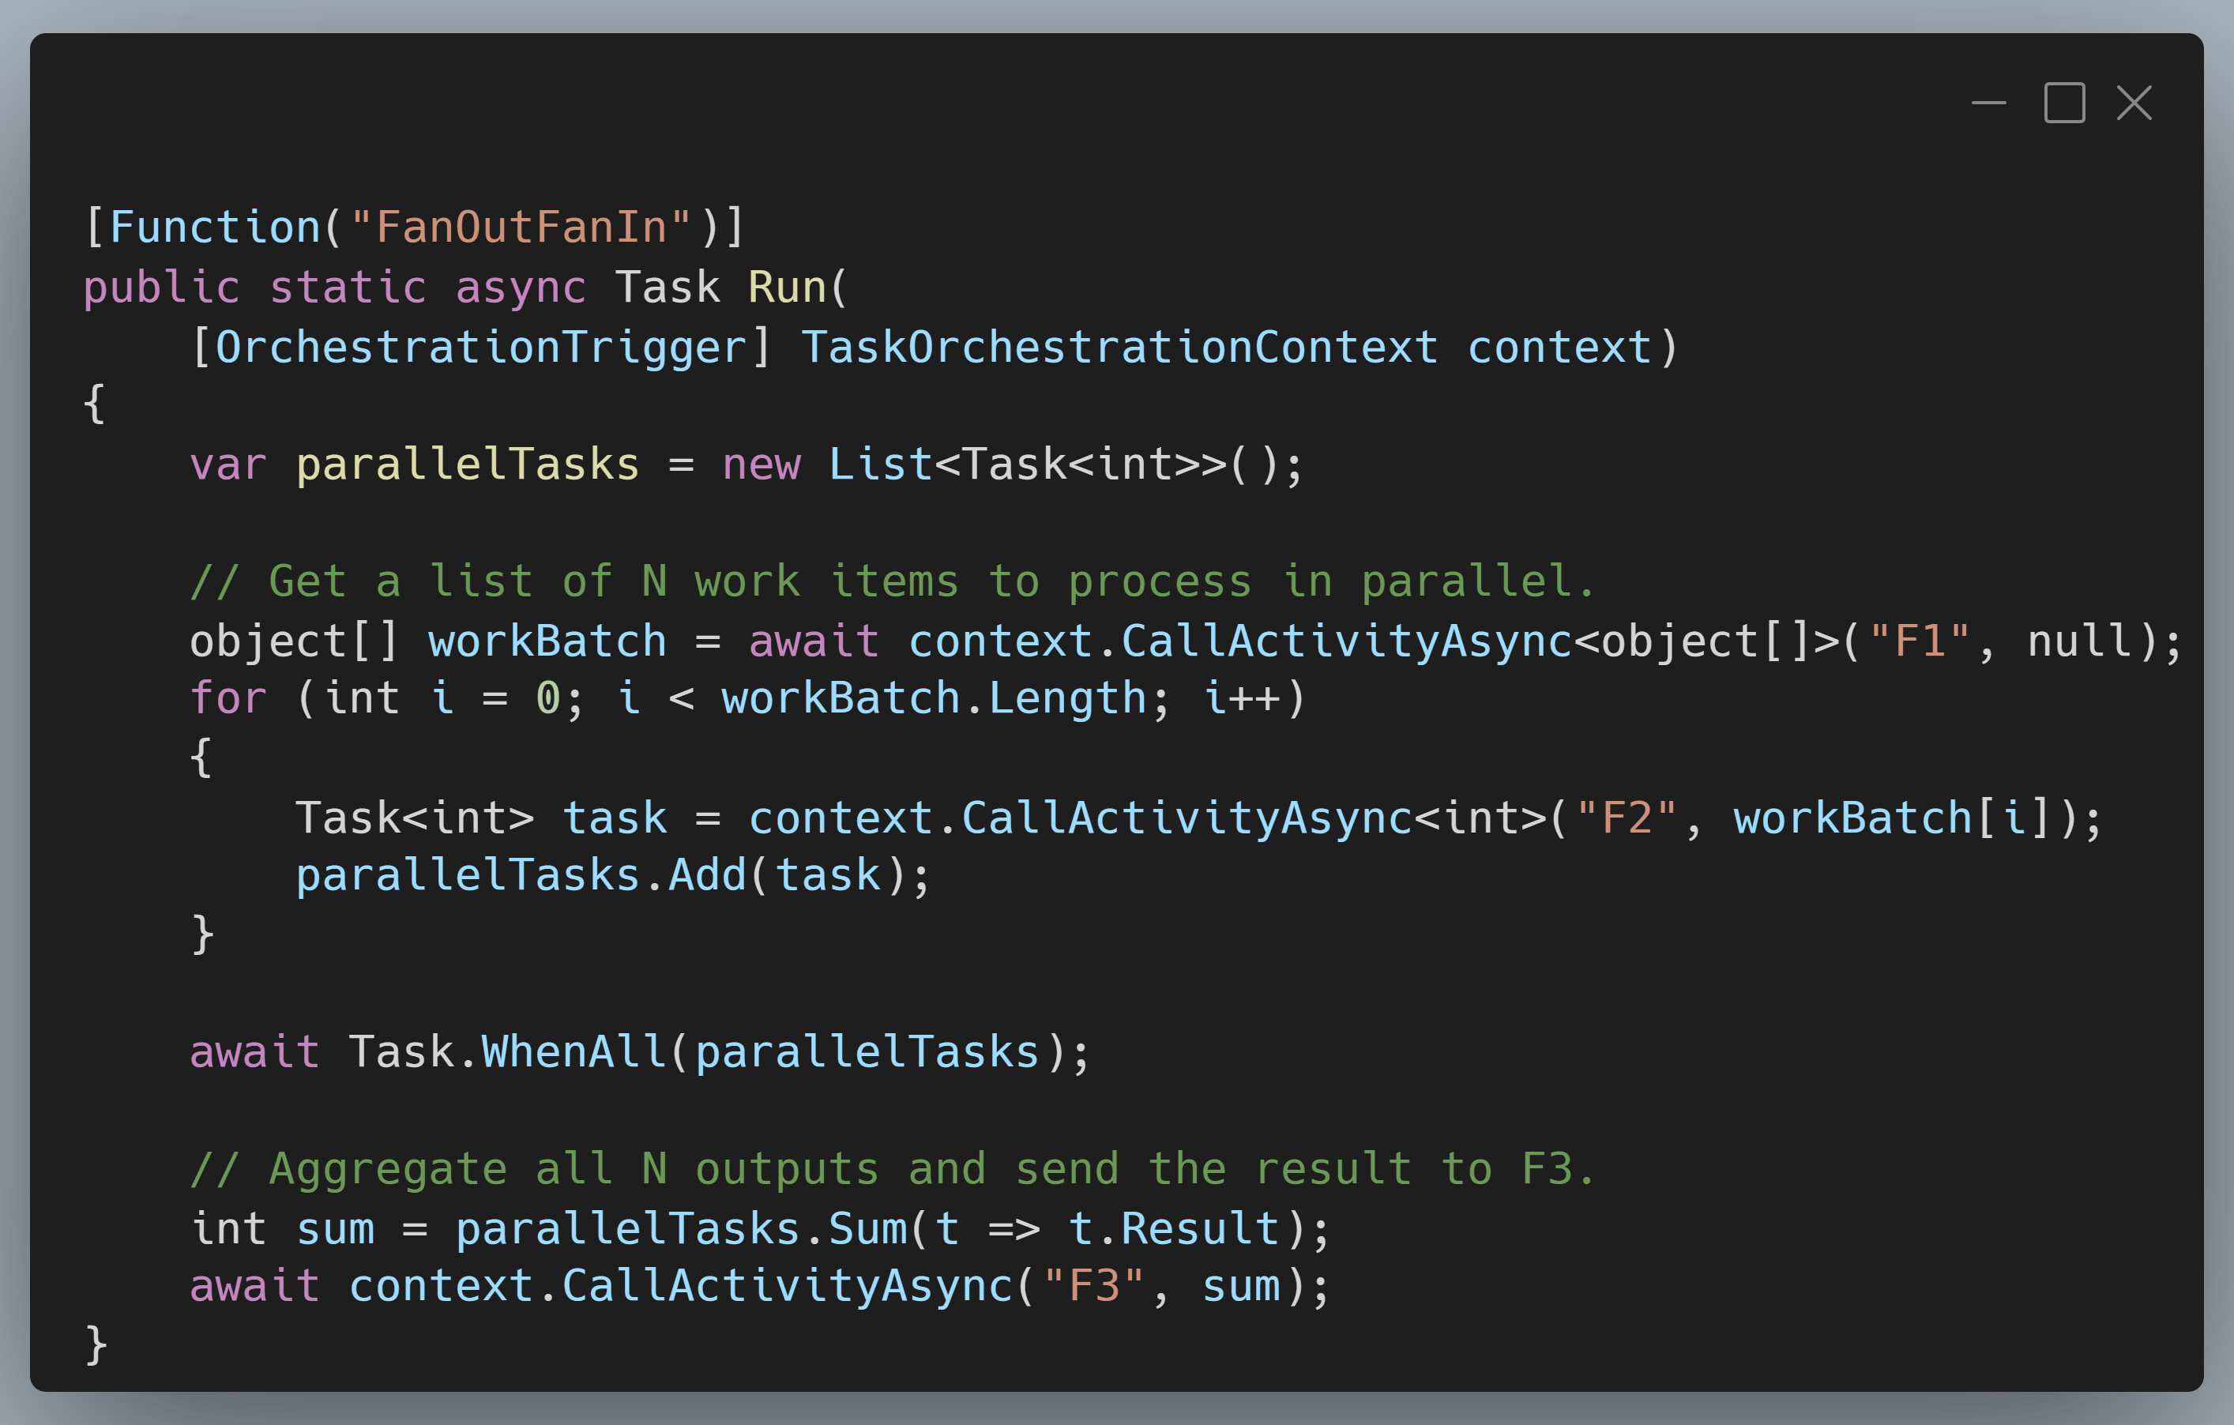
Durable Functions: Fan In/Out

Slide 44
Conclusions
Notes:
Important to abstract out background tasks from your UI or front facing work

Slide 45
Thanks! Have a great conference!

